Slide 1

M13 widget

Slide 2
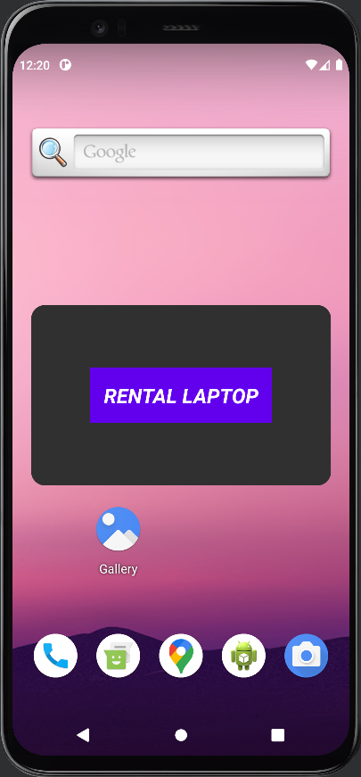
CONTOH IMPLEMENTASI

Slide 3
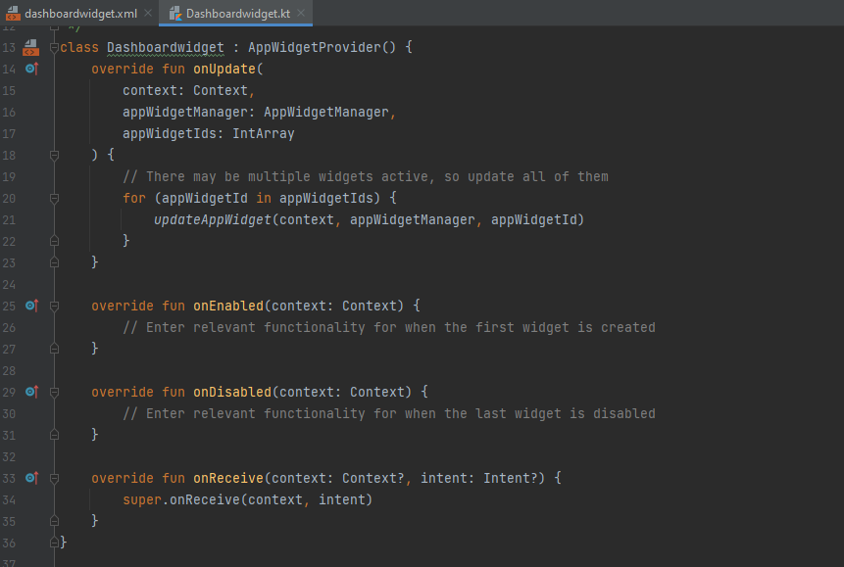
WIDGETDASHBOARD

Slide 4
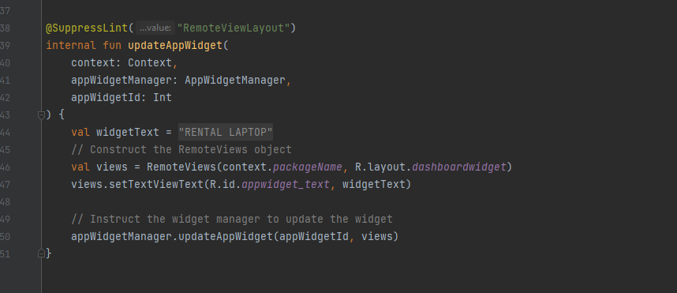

Slide 5
M14 FIREBASE

